Slide 1
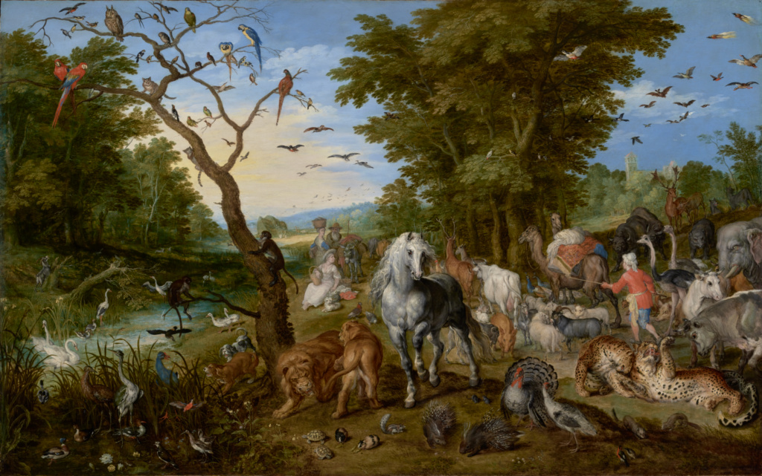
Algorithmic Extraction of Keywords, Concepts, and Vocabularies
Max Irwin
November 14, 2018

Slide 2
Agenda/Intro
Agenda
This slide
Why I’m talking
What I’m talking about
How to do what I’m talking about
Overview of tools and techniques
Where new research is headed
Questions

Slide 3
Why I’m talking. (Problem statement)
Information Retrieval Problems
Product Problems
Suggesting stuff to users
based on what?
Content clustering/relationships/similarities
but how?
Slots and intent for Queries and Bots
with what?
Entities and Named Entity Recognition
sourced from where?
Question Answering
how can it know?
Dimension reduction for unstructured text
down to what?
Lots of products in different domains
Law, Tax, Health, Marketing, Etc.
Better search with less effort
Shortage of metadata experts
Domains differ, content proprietary
Lots of work, always from scratch
Terms of Art, Concepts, Vocabularies, take years to curate manually
They are usually subjective
My goal is to introduce you to a suite of techniques to help solve the above problems
Notes:
So, many of us here deal mostly in unstructured text. We do our best to help customers find things ensconced in corpora, trying to make their lives easier and more efficient. We often see patterns in the text ourselves and wish that, perhaps, this thing was metadata or that thing was normalized. So when given a bag of words, we take out our bag of tricks. We Lemmatize, we ASCII Fold, we catenateWords, we boost and tune. Doing our best to make things nice and tidy, coherent and findable. But almost always we do this inside the engine while processing content and queries.
But it is easy to lose sight of the overall problems when deep in our analyzers working through search bugs. Two main issues in search come down to context and intent. What is the customer really looking for? Can’t they be more expressive and less vague? An enormous gap exists because there isn’t any machine understanding of content, and an inverted index can’t connect with the customer in any meaningful way. A document or fragment is always about something, and it’s in a certain context. Being able to express that in an abstraction is what leads towards relating to the customer, their query intent, and goal for using your product in the first place.

Slide 4
What I’m Talking About.
A survey of technologies for automatically extracting the following from text
Keywords
Concepts
Ontologies/Taxonomies
Terms associated with documents
Classify and associate documents
Techniques:
LDA,
RAKE,
Maui
Associates terms with the same semantic meaning (synonyms)
Building blocks for vocabularies
Techniques:
Topia,
Skipchunk
Represent entire domains (or subsets)
Reduce dimensions for abstracting domain corpora
Techniques:
Lexico-syntactic patterns,
TAXI
Notes:
We have difficulty representing a domain in plain terms, and reducing the dimensions of the content in that domain. We can do it but it takes time and specialist expertise.
So with that we look to automate. We automate not because we are lazy but because it saves time, removes bias, and broadens our ability beyond what we can achieve with our human minds and learned skills. We will automatically abstract across a corpus and I’m going to be talking about how to do that with tools and techniques. Some of these are flat, and some have deeper structure. Ultimately a domain is abstracted through an Ontology, which is a graph of core concepts and their relationships, sometimes hierarchical, but sometimes messy and bidirectional…but that’s fine because our mental representation of the world is never simple.
I only have 40 minutes, and these techniques are not exhaustive. Rather they are selection across a spectrum with varying use cases and degrees of accuracy. There is a whole world of research being done in this space that, at least in my normal day to day activities, rarely sees light or application to the hard problems we have. This world is hidden away in brilliant academic research and sometimes available through proprietary and expensive black boxes. So over the past several years I’ve been casually researching. In preparation for this talk, for the past couple months, I dug myself in deep and learned as much as I could in my spare time, by reading dozens of papers and trying all sorts of technology. Many thanks to OpenSource Connections for giving me an opportunity to speak today. And I hope you are able to take what I’ve distilled here and find some inspiration and new ways of thinking. Since much of this research is about the most important thing that we deal with: language.

Slide 5
How do these tools work?
General Workflow
Testing!
Get candidates
Preprocess, arrange, and group tokens
Score candidates
Assign each entry a confidence weight
Relate candidates (only for taxos/ontos)
Link into hierarchies or triples
Score the relationships
Finish and generate list or vocab
Keep “best” scored candidates
Keep “best” scored relationships
Prune (optional step, sometimes human)
Remove noise and cleanup
Precision/Recall/F1 to measure vs existing keywords/vocabs
Can also use relevance testing like nDCG if applying to Search
Use open sets if available (SemEval has good ones)
Otherwise, curate one manually
Varies between experts, so get consensus!
Notes:
We’re not yet at the point where things end up perfectly nice and clean in the end. Many of the techniques will require a human touch to finish things off nicely, just to make sure our naïve and deterministic automatons are doing their job correctly. So unless you are web scale and can’t possibly take the time to have a person comb through the results, I recommend doing just that and over time finding good ways to replicate.

Slide 6
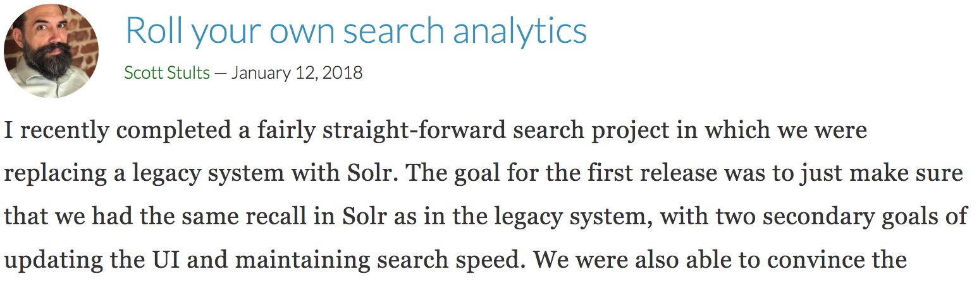
Our Example Corpus
https://opensourceconnections.com/blog/
Quality content written by our hosts and community members
Articles are lacking keywords, and search doesn’t give term suggestions!
Highly contextual to the audience
Notes:
Used wget to grab ~700 articles

Slide 7

Topics, Keywords, and Concepts
LDA, RAKE, Maui, Topia, Skipchunk

Slide 8
Latent Dirichlet Allocation (LDA)
Unsupervised ML for topical classification of documents
“if observations are words collected into documents, [LDA] posits that each document is a mixture of a small number of topics and that each word's creation is attributable to one of the document's topics” - wikipedia
How it works:
Give it a corpus (pre-processed into nice tokens)
Specify an exact number of topics and train
Uses Dirichlet prior for Bayesian probability of each term to a topic
The topics are identified and assigned to the documents
Trained model is re-used to classify new documents
Language independent, well established statistical proofs
Downsides: Can be nondeterministic, intensive training, model maintenance

Slide 9
LDA – Example Corpus Topics
Steps
Resulting Topics
Using Gensim LdaModel
Steps:
Tokenize the content
Remove non-words and stopwords
Stem or lemmatize
Train the model (with 20 topics)
See the topics!
Save the model and use it later to classify new documents with topics
0.109 search
0.087 use
0.079 can
0.06 queri
0.049 open
0.046 sourc
0.043 data
0.041 solr
0.04 like
0.037 field
0.031 document
0.027 score
0.026 result
0.025 user
0.024 will
0.023 govern
0.022 term
0.021 match
0.017 databas
0.017 depend

Slide 10
Rapid Automatic Keyword Extraction (RAKE)
Novel language independent technique, very fast, and bag-of-words friendly
Also proposed a nice stopword selection algorithm as part of the paper
Candidates:
Tokenize
Split token groups by punctuation and stopwords
Identify co-occurances of sequences of unfiltered words
Scores:
Co-occurrences of tokens t=1..n are used for scoring as k_{t}=degree(t)/frequency(t)
Keywords are re-adjoined as candidate phrases with score = sum member token k
Selection
Top third best scoring candidate phrases are kept
Downsides: Relies heavily on Frequency, Patented ☹

Slide 11
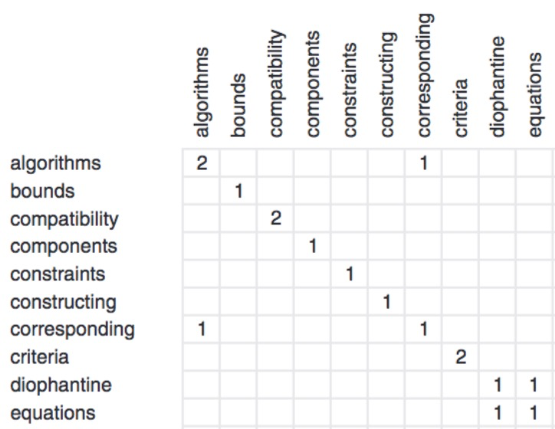
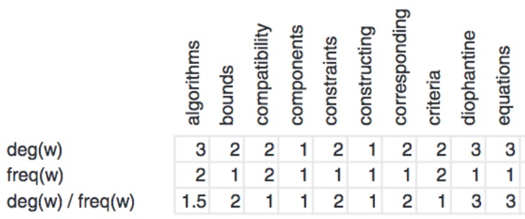
RAKE algorithm in one slide
“For search managers, developers & data scientists finding ways to innovate”
For search managers, developers & data scientists finding ways to innovate
Constructing criteria bounds = 1 + 1 + 2 = 4
Corresponding components = 2 + 1 = 3
Compatibility algorithms = 1.5 + 1 = 2.5

Slide 12
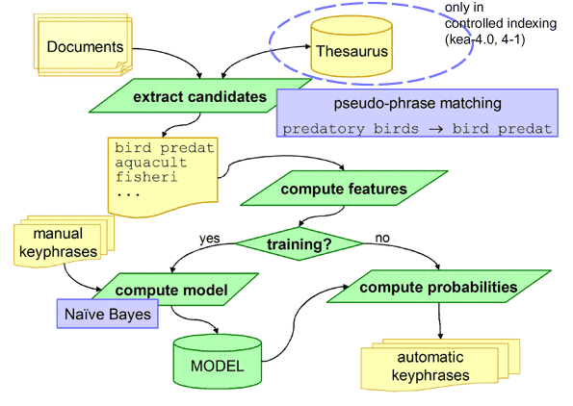
Multi-purpose automatic topic indexing (“Maui”)
Upgrade on the “KEA” tool
Trains a Naïve Bayes Classifier with the Weka ML framework
Can draw from existing vocabs
Multi-Purpose:
Assign terms with a controlled vocabulary
Index subject headings
Extract keywords and key phrases
Link entities
Extract terminologies
Generate automatic tagging
Downsides: Requires a training set, model maintenance
Notes:
If thesaurus is provided, its concept labels are used to identify candidates.
Candidate Keywords are continuous token n-grams of declared length from 1 to 3. Candidates do not start or end with a stopword.
Candidate scoring features are TFxIDF, First Occurrence (beginning and end of documents are favored), number of tokens, and Node Degree (related to a thesaurus).

Slide 13
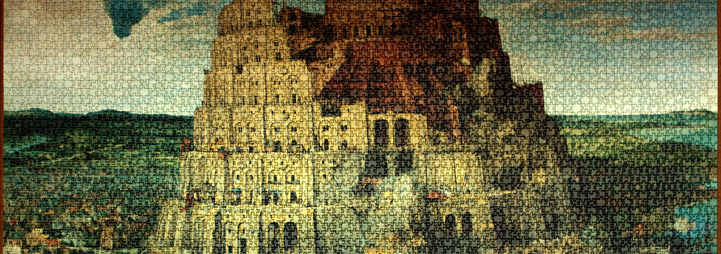
Using NLP Libraries
Language is Hard

Slide 14
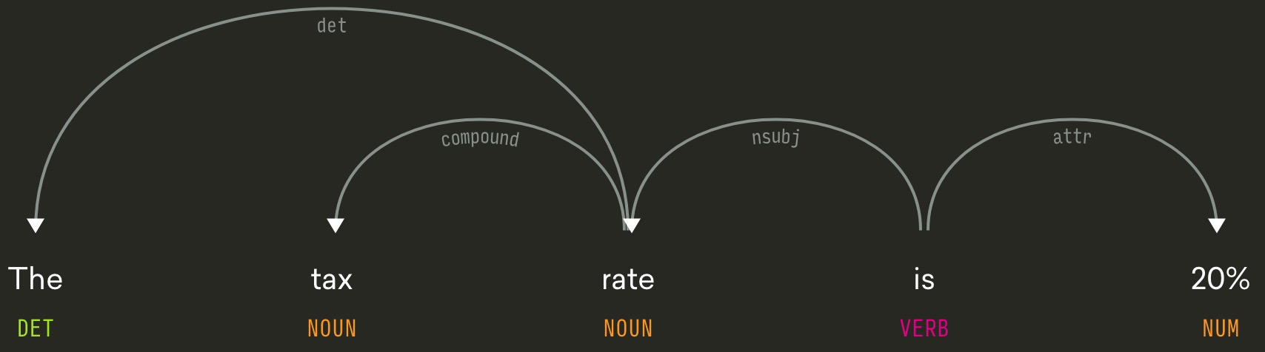
Part of Speech tagging - 30 second overview
Sentence to Tree: PoS Tagging and Edge Labeling.
Based on training data from a Treebank
Treebanks are usually not domain specific
Lack of domain specificity can decrease accuracy
When it works, it is useful for many applications
The tax rate is 20.0%
https://demos.explosion.ai/displacy/?text=The%20tax%20rate%20is%2020%25

Slide 15
NLP vs Legal Content
Parsing this sentence from the news will have a happy outcome:
Parsing this sentence from case law might have a sad outcome:
“The stock price for ACME inc. jumped 10% due to yesterday’s positive news.”
“[1955] Ch. 634 Page 649 However, to cite a passage from the judgment of Maugham J. in In re Etic Ld. (1) In that case the judge made reference to Coventry and Dixon's case (2) and certain other cases, and then he said (3) this, of the language of Sir George Jessel M.R. in In re Anglo-French Co-operative Society; Ex parte Pelly (4): "The language of Sir George Jessel in dealing with the matter in his decision in Ex parte Pelly (4) strongly tends to show that in his view section 215" (now section 333 of the Act or 1948)“ really only applies where there has been some wrongful act by the director, manager, liquidator, or other officer of the company, either of the nature of misfeasance, or of the nature of breach of trust in a wide sense, including no doubt a breach of trust by negligence, or something of that kind.”

Slide 16
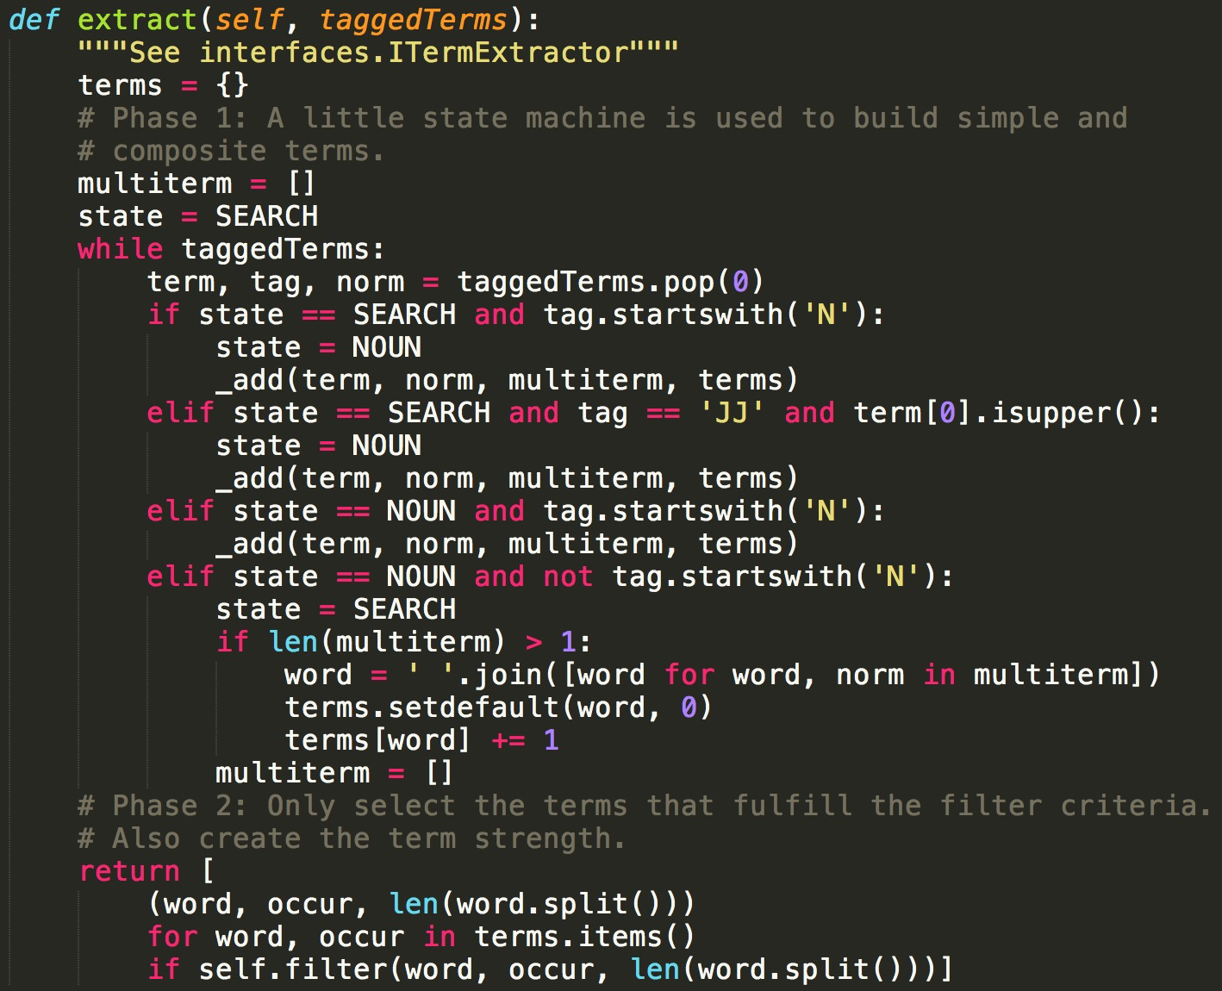
Topia TermExtract
Python2 library: Topia.termextract
Algorithm:
Tags Part-of-Speech* for all terms in corpus
Find noun phrases using patterns of tags
State machine groups nouns and adjectives
~25 lines of python2
*Depends on NLTK, Part of Speech tagging accuracy varies (75%-92%)
Score and Filter:
Term frequency
Term length
Can be changed with a plugin
Simple but effective
Downsides: favors single token terms

Slide 17
Skipchunk
I made this ☺. The name is because it Skips noise to Chunk concepts and predicates.
Extracts flat SKOS concepts and predicates by finding similar label forms.
Algorithm:
Tags Part-of-Speech* for all terms in corpus
Lemmatize and switch to de-adjectival** nouns where appropriate
Take greedy noun/verb phrases, use sorted nouns/verbs in the same phrase of as a key identifier
Group sloppy noun phrases (concepts) and verb phrases (predicates) with the same key
Score is the total count of all label variations, prefLabel is the shortest variation
* Used NLTK at first but migrated to spaCy (90%+ PoS tagging accuracy)
**(beautiful → beauty), uses wordnet (needs accuracy improvement though)
Extra long chunks on purpose: they are likely to be terms of art with other forms
invite practitioner
key
With Haystack we want to open up the invite to practitioners from
ADP PROPN PRON VERB PART VERB PART DET NOUN ADP NOUN ADP
around the world similarly struggling on hard meaty relevance problems.
ADP DET NOUN ADV VERB PART ADJ ADJ NOUN NOUN
Notes:
Skipchunk is greedy and likes to include modifiers, since they are frequently included in terms of art for the domains we work with, such as “qualified buyer exemption” or “regulated investment company”. It also includes stop words like “tax for the year” and another label for the same concept as “the year’s tax”. However leading and trailing stopwords are removed. The second label in the previous example will become “year’s tax”

Slide 18
Skipchunk – example extractions
Concepts (Noun Phrases)
Predicates (Narrow Verb Phrases)
skos:prefLabel "twitter / facebook"@en ;
skos:altLabel "facebook and twitter"@en ;
skos:prefLabel "drupal search block"@en ;
skos:altLabel "search to any drupal block"@en ;
skos:prefLabel "top search terms"@en ;
skos:altLabel "top 100 search terms"@en ;
skos:prefLabel "document’s term vectors"@en ;
skos:altLabel "term vectors from documents"@en ;
skos:prefLabel "last longer"@en ;
skos:altLabel "longer lasting"@en ;
skos:prefLabel "was uploaded"@en ;
skos:altLabel "is that we can upload"@en ;
skos:prefLabel "woke up early"@en ;
skos:altLabel "woke us all up early"@en ;
skos:prefLabel "so you see"@en ;
skos:altLabel "so when you see"@en ;
skos:altLabel "so you can see"@en ;

Slide 19
Showdown! Top 20 from the example corpus
LDA
RAKE
MAUI
Topia
Skipchunk
search
use
can
queri
open
sourc
data
solr
like
field
document
score
result
user
will
govern
term
match
databas
depend
trek holodeck
hồ chí minh
premium unsanded grout
prank bubble gum
weird art film
dog catcher law
latent semantic analysis
open source connections
tf*idf score
probabilistic information retrieval
open source solutions
open source search
inverse document frequency
open source software
open source community
google search appliance
test driven relevancy
social networking sites
semantic web technologies
open source projects
solr
ve
machine learning
filtering that information
ranking
training set
training data
providing information
retrieval systems
machine learning techniques
query with rankings
cheat
installs git
extensive amounts
clean package
parent project
solr 4.X
mvn clean
custom relevancy
matches like
search
solr
query
user
data
document
result
time
use
work
field
project
name
example
term
need
way
code
problem
thing
search engine
search results
opensource connections
otherness words
open source
search relevance
use case
search terms
frequencies for all four terms
blog post
solr or elasticsearch
visual studio
document frequency
otherness hand
dependencies downloading
query time
Eric Pugh
recommendation systems
title field
big data
Notes:
Some things to notice: LDA and Topia are very similar and have lots of overlap, but this is for the entire corpus and further classification will produce much different results for each subsequent document.
RAKE has lots of very odd terms seemingly out of domain context (“weird art film”, “trek holodeck”) attributed to their frequency in the posts, this can be tuned.
Maui has a nice mix of single and multiple token terms, but some noise (like ‘ve’ and ‘matches like’).
Skipchunk has some de-adjectival noun bugs (“in other words” ➔ “otherness words”).

Slide 20
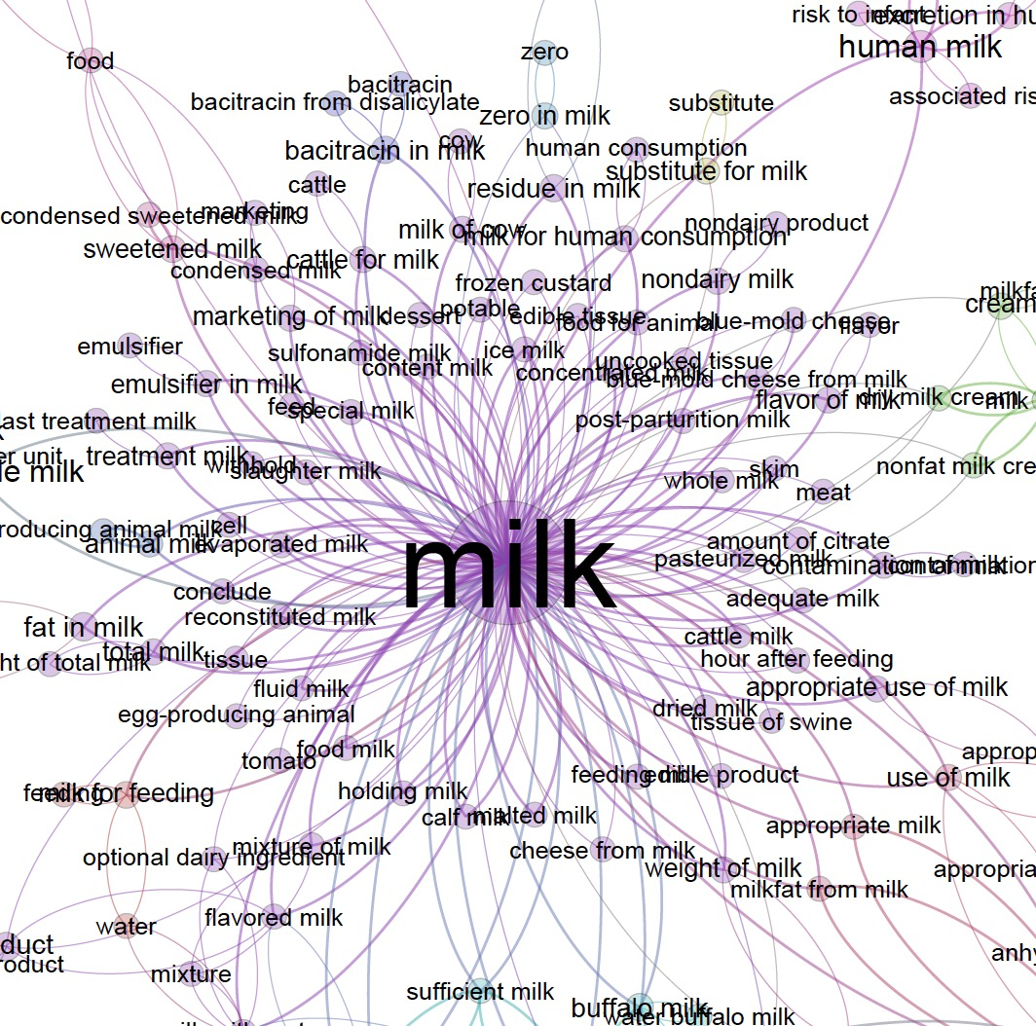
Ontology learning
Specifically – Terminological Ontologies (SKOS, WordNet, Etc)
Taxonomies are hierarchical
Can narrow focus to Hypernym Discovery (SemEval 2018 task 9)
More broadly, Taxonomy extraction, Hyponym detection
SemEval challenges for state of the art
Don’t forget Meronymy (membership)!
Image Source: Nuria Casellas, 2012

Slide 21
Types of Ontologies
Formal:
a conceptualization whose categories are distinguished by axioms and definitions. Can be used to computationally and logically arrive at exact proven conclusions.
Prototype-based:
distinguished by typical instances or prototypes rather than by axioms and definitions in logic. Categories are formed by collecting instances extensionally
Terminological:
partially specified by subtype-supertype relations and describe concepts by concept labels or synonyms rather than prototypical instances, but lack an axiomatic grounding. SKOS, WordNet, BabelNet are examples
Source: C. Biemann, 2005

Slide 22
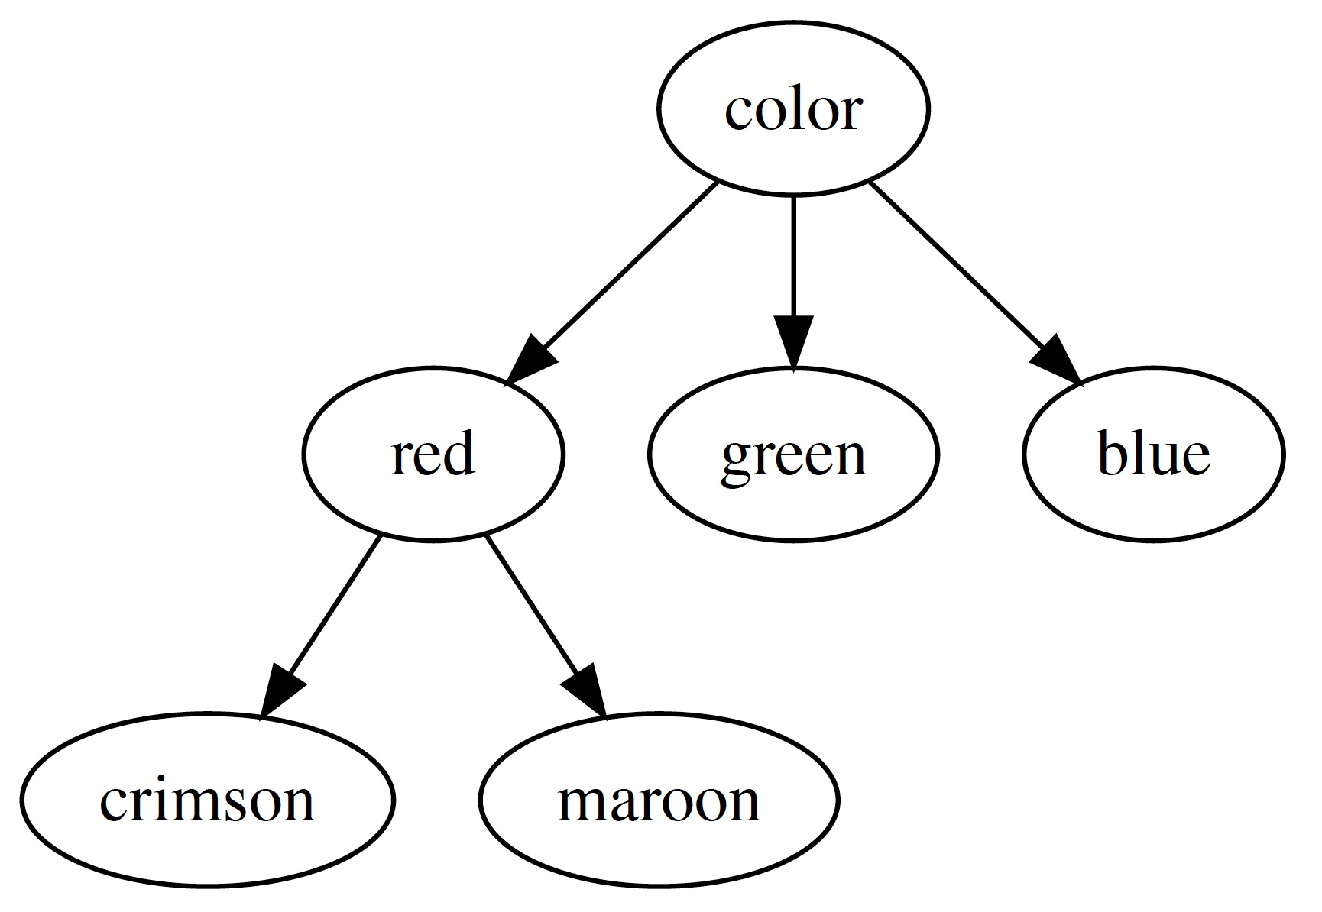
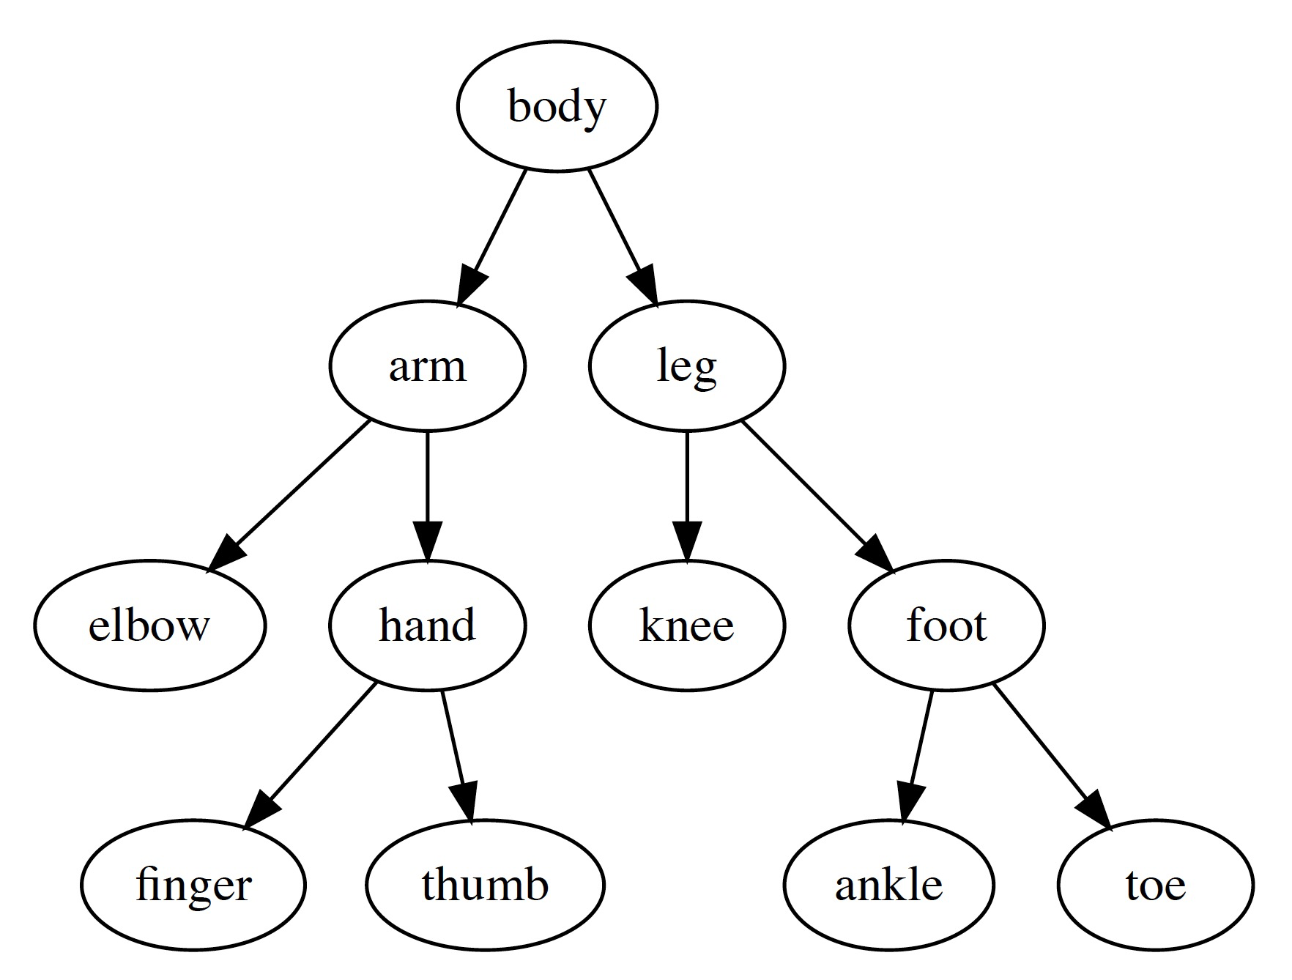
Hypernymy and Meronymy
Hypernym
Hypernymy➔ Classification
(“is a” relationships)
Hypernym
AND
Hyponym
Co-Hyponyms
Hyponyms
Meronymy➔ Membership
(“part of” relationships)
Meronyms
Meronyms
Meronyms
Meronyms
Meronyms

Slide 23
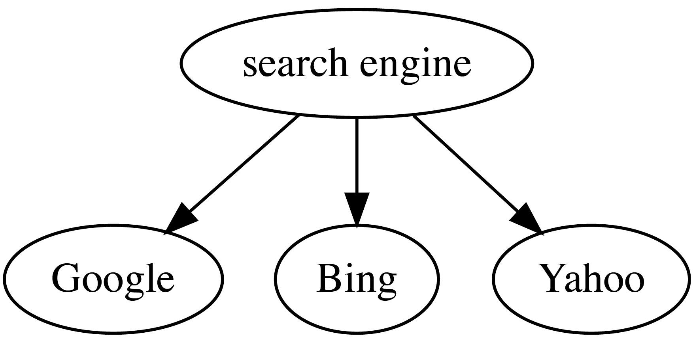
Hearst Patterns (Lexico-Syntactic)
“…traffic comes from an external search engine such as Google, Bing, or Yahoo”
“Automatic Acquisition of Hyponyms from Large Text Corpora”
Marti Hearst, 1992. Cited by 3504 in Google Scholar
Hard and fast rules based on language syntax
Uses trigger words and punctuation
NP₀ such as {NP₁,NP₂ …, (and | or)} NP_{n}
for all NP_{i}, 1<=i<=n, hyponym(NP_{i}, NP₀)
Therefore: hyponym(“Bing”, “search engine”)
such NP as {NP,}* {or|and} NP
NP {, NP}* {,} or other NP
…
Lexico-Syntactic patterns have improved with research and expanded to Meronyms
Notes:
Marti Hearst proposed the original 6 patterns. The research was so early (pre-web!) that it was difficult to scale the analysis and in some steps she had to resort to manual work rather than computation. It is worth noting that though Noun Phrases are specified, these were discovered as part of the pattern, and not pre-computed for discovery.

Slide 24
Lexico-Syntactic Pattern Success Rate
Success!
Not so much success
Some animals such as dogs
Countries around the world such as Armenia
Pattern | Occurrences* | Success Rate*
NP₀ including NP₁ | 601 | 409 (68.0%)
NP₀ such as NP₁ | 2389 | 2107 (88.2%)
NP₀ like NP₁ | 401 | 330 (82.0%)
NP₀ e.g. NP₁ | 170 | 134 (79%)
NP₀ kinds|types|forms of NP₁ | 48 | 31 (65%)
NP₀ especially NP₁ | 61 | 54 (89%)
NP₀ notably NP₁ | 22 | 13 (59%)
*Source: Klaussner and Zhekova, 2011
Notes:
Researchers Klaussner and Zhekova discovered and added new patterns, and did thorough analysis on their success rate.

Slide 25
TAXI – A Taxonomy Induction System
State of the Art
First place in SemEval 2016 Task 13 (Taxonomy extraction evaluation)
Innovations:
Hundreds of TB of general domain content
Focused Crawl of specific domain content
Substring Matching and Lexico-Syntactic Patterns together, ported to four languages
Unsupervised and Supervised learning, based on the language
Automated pruning of the graph
Domain Content on the Web
Corpus
& Web
Overlap
Original to the Corpus
Notes:
Everything we’ve seen so far has been using the documents that are part of the corpus being analyzed, or use models that are sourced from controlled content
Your domain isn’t new and while your content can be original, there is going to be significant overlap with existing and publicly available knowledge.
The focused crawl works well because it draws on the intelligence and scale of the web. When Hearst first published her Lexico-Syntactic patterns, the material was locked away in books or newly digitized content, therefore much of the extraction was original.
Nowadays, while the corpus may have original material unseen beforehand, the bulk of the domain is encapsulated by existing and publically available knowledge on the web.
This uses existing information to get statistically significant likelihood of hypernymy, and apply that likelihood to the new material and corpus structure.
The Taxonomy is still specific to the corpus, but it is improved by drawing from this likelihood. While in many ways this is a brute force approach, its success is a testament to the idea of learning from data at scale.

Slide 26
TAXI Workflow
Gather lots of Content
Candidate Hypernyms
Prune Candidates
Construct Taxonomy
General
Wikipedia(11GB)
59G (59GB)
Common Crawl (168TB)
Specific
Focused Domain Crawl
Lang modelling approach
e.g. food, science, enviro
Thorough
Takes 1 week per language per domain
Substr matches
“Biomedical science” ➔ science
“Microbiology” ➔biology
Calculate Score: σ(t_{i} ,t_{j})
Lexico-syntactic
PattaMaika (NLP chunks)
PatternSim (Hearst, etc)
WebISA (rexexp patterns)
Calculate Score: π(t_{i} ,t_{j})
Unsupervised
French, Dutch, Italian
t_{i} is hypernym of t_{j} if:
σ(t_{i} ,t_{j}) > 0
OR
π(t_{i} ,t_{j}) rank in top 2
Supervised
English Only
Use trained SVM classifier from existing taxo
Model incorporates Negative Sampling
Classifies all possible word pairs, positives get added
Steps
Start with the noisy graph
Use graph pruning techniques
Remove cycles and bidirectionals
Makes a Directed Acyclic Graph
Attach top nodes to root
End result is a Taxonomy
Notes:
Note the maturity of the stack which draws on many techniques previously discussed. Extra steps were taken to ensure success with all four languages as specified in the SemEval task.

Slide 27
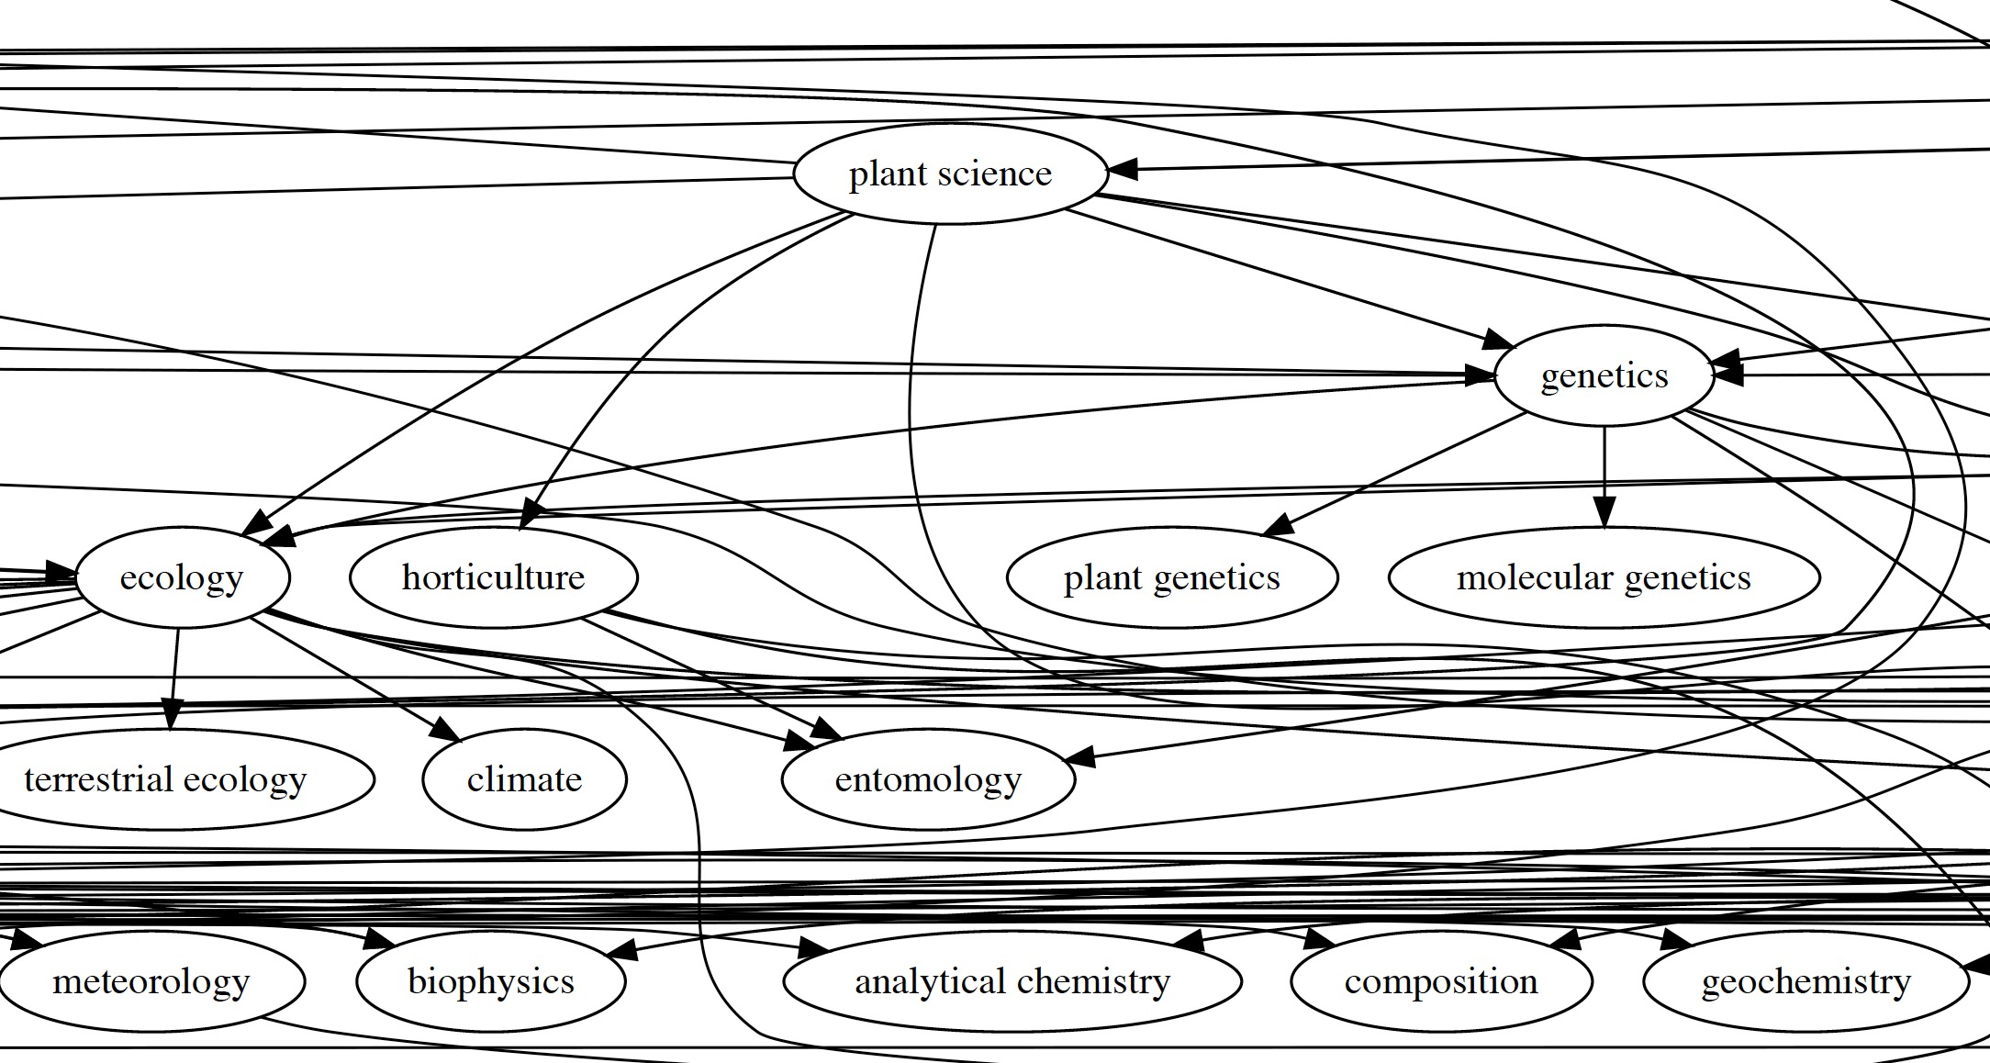
TAXI - Science Domain Example Graph
Notes:
I wasn’t able to apply TAXI to our example corpus in time for this talk, so I used the SemEval ‘Science’ domain evaluation instead. Nevertheless, the concepts in TAXI are indeed powerful and warrant further investigation, whether used as-is or as a reference for development.

Slide 28
Use Cases and Applicable Techniques
Supervised
1. Document Classification
Maui → 1,2,3
Unsupervised
2. Enriching Content
TAXI → 4,5,6,7
3. Terms for Query Suggestion
LDA → 1,2,5
4. Grouping Similar Terms
RAKE → 1,2,3
5. Relating Concepts
Topia → 3
6. Taxonomy Generation
Skipchunk → 3,4,5,7
7. Ontology Bootstrapping
Hearst → 4,5,6

Slide 29
What’s Next?
For the Field
For Skipchunk
Trending to tasks being split:
Hypernym Detection
Hypernym Discovery
Taxonomy Construction
Taxonomy Evaluation
Word-Embeddings and Deep Learning are becoming more prevalent in the above tasks
Improve Accuracy
Generation of RDF triples
Use common predicates and leverage substrings and lexico-syntactic patterns
Known issues that make things hard:
Co-reference resolution
Intransitivity
Passive vs Active voice

Slide 30
References
DataSets
https://opensourceconnections.com/blog/
https://github.com/zelandiya/keyword-extraction-datasets
Tools:
https://graphviz.readthedocs.io/en/stable/
http://www.nltk.org/
https://spacy.io/
LDA
http://www.jmlr.org/papers/v3/blei03a.html
https://radimrehurek.com/gensim/models/ldamodel.html
RAKE
https://pdfs.semanticscholar.org/5a58/00deb6461b3d022c8465e5286908de9f8d4e.pdf
Maui/Kea
https://github.com/zelandiya/maui
https://code.google.com/archive/p/maui-indexer/
https://www.airpair.com/nlp/keyword-extraction-tutorial
http://community.nzdl.org/kea/
https://code.google.com/archive/p/kea-algorithm/downloads
Topia
https://pypi.python.org/pypi/topia.termextract/
Hearst
http://people.ischool.berkeley.edu/~hearst/papers/coling92.pdf
https://github.com/mmichelsonIF/hearst_patterns_python
http://www.aclweb.org/anthology/R11-2017
https://www.researchgate.net/publication/306072432_Automatic_Extraction_of_Hypernym_Meronym_Relations_in_English_Sentences_Using_Dependency_Parser
TAXI
https://www.lt.informatik.tu-darmstadt.de/de/software/taxi-a-taxonomy-induction-system/
http://alt.qcri.org/semeval2016/task13/
http://web.informatik.uni-mannheim.de/ponzetto/pubs/panchenko16.pdf
http://tudarmstadt-lt.github.io/taxi/
Ontology Learning:
http://www.jlcl.org/2005_Heft2/Chris_Biemann.pdf
http://www.semantic-web-journal.net/system/files/swj311_2.pdf
https://competitions.codalab.org/competitions/17119
https://www.researchgate.net/publication/221303651_Lexico-Syntactic_Patterns_for_Automatic_Ontology_Building
What’s Next:
https://arxiv.org/pdf/1703.04178.pdf

